Slide 1


Slide 2
C O M P R E H E N S I O N S

Slide 3

Introduction to Comprehensions
What are Comprehensions?
Provide a concise way to create lists, dictionaries, and sets
Condense multiple lines of code into a single line
Make the code more readable and efficient
Types
List Comprehensions
Dictionary Comprehensions
Set Comprehensions

Slide 4



List Comprehensions
Allow to create lists based on existing iterables (like ranges or other lists)
Apply transformations or filtering elements as needed
This creates a list squares containing squares of numbers from 0 to 9
OUTPUT

Slide 5
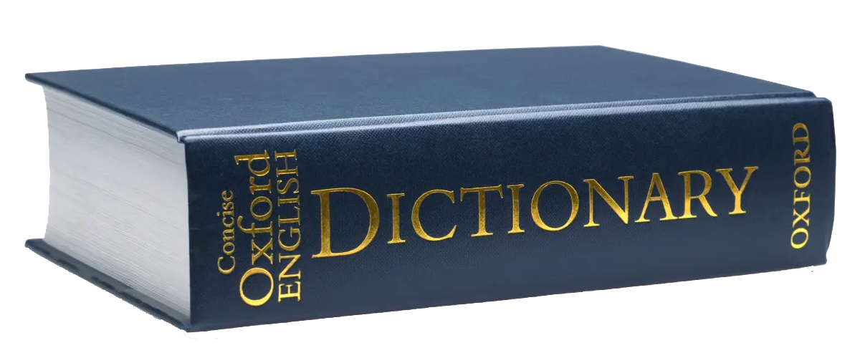


Dictionary Comprehension
Create dictionaries by specifying key-value pairs
Derived from an iterable
Often with conditions for filtering or transforming data
This generates a dictionary squares_dict where keys are numbers from 0 to 4, and values are their squares
OUTPUT

Slide 6
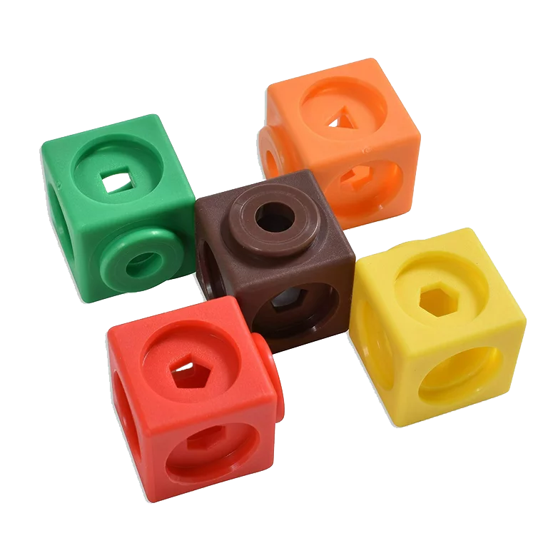


Set Comprehension
Produce sets by similarly transforming or filtering elements
Derived from an iterable
Ensuring all elements are unique
results in a set squares_set containing unique squares of numbers from 0 to 9
OUTPUT

Slide 7
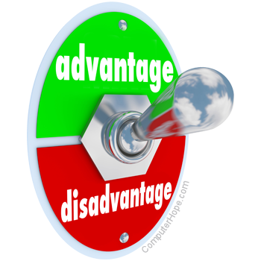
Advantages of Comprehension
Streamline code
Enhance code readability and maintainability
Make Python code more expressive and efficient

Slide 8

Why list comprehensions are useful in Python?
It is a concise way to create lists in Python
How dictionary comprehension is different from set comprehension?
Dictionary contains key value pairs, while set doesn’t

